Slide 1

Lung Cancer Detection False Positive Reduction
Brégeat Joseph
Bucciarelli Vittoria
Gerletti Sebastian Edoardo
Kassem Karim
Mazzucchelli Umberto

Slide 2
INTRODUCTION
1

Slide 3
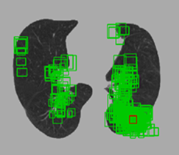
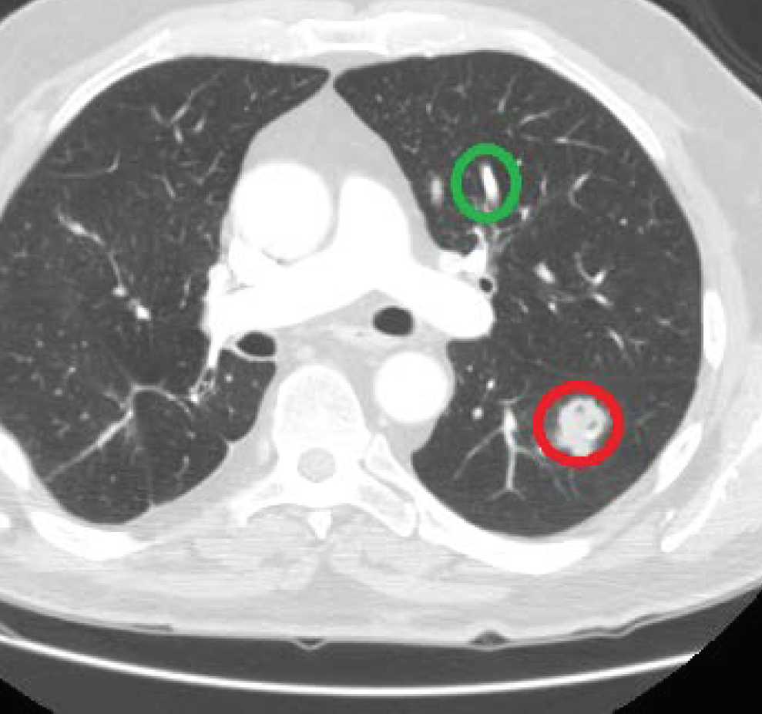
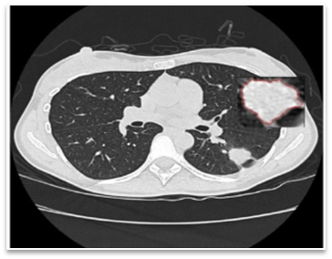
LUNG CANCER
1.3 million deaths annually
Candidate screening
Need for early diagnosis from LDCT scans
Computer aided detection system
TP
False positive reduction
FP

Slide 4
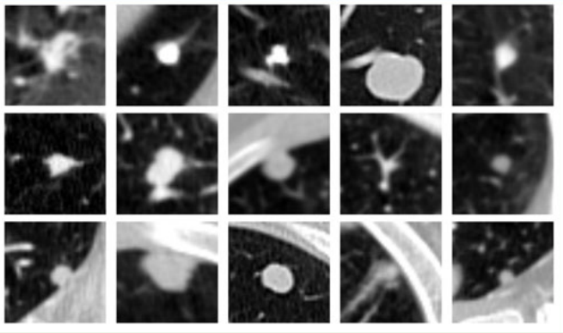

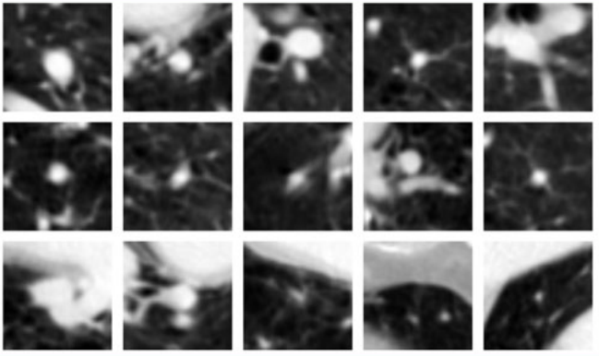

FALSE POSITIVE REDUCTION
Similar appearance of FP and TP nodules
Noisy background
Overdiagnosis
Heterogeneous size, shape and location
True positives
False positives

Slide 5

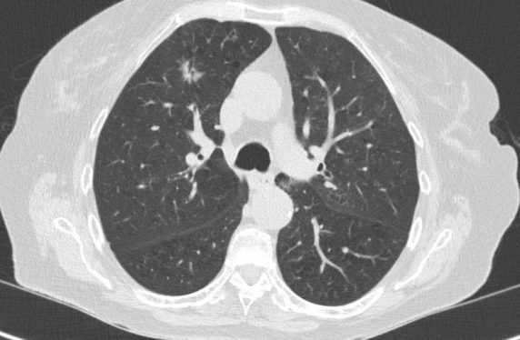


WHY 3D CNNS?
3D spatial information
Multilevel contextual information
High discrimination capability
High detection accuracy
Archi1
Archi2
Archi3

Slide 6
WHAT WE DID
Implementation of Archi1, Archi2 and Archi3
New image processing technique
Networks combination and performance evaluation
1
1
3
5
2
4
6
Comparison of the performances with the old and new processing technique
Choice of the best model
Optimization of the 3 networks separately
1: Dou et al., Multilevel Contextual 3-D CNNs for False Positive Reduction in Pulmonary Nodule Detection, 2017

Slide 7
IMAGE PROCESSING TECHNIQUE
2

Slide 8
Original Dataset Before Augmentation
DATASET FEATURES

Slide 9
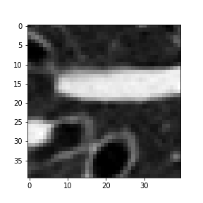
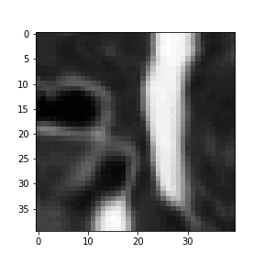
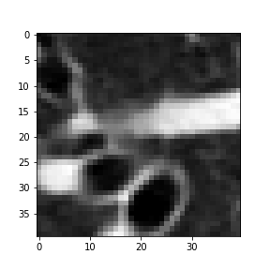
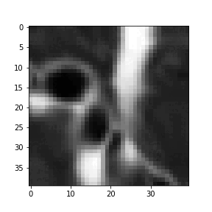
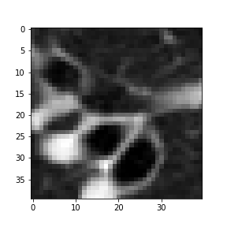
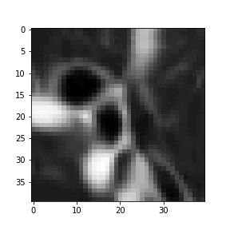
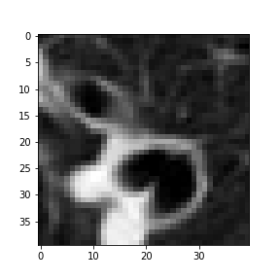

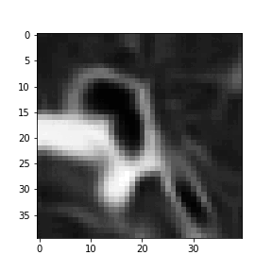
DATA AUGMENTATION
Original Voxel
Voxel Decomposition
Augmentation
Voxel Reconstruction
Slice height
ARCHI MODELS
(Training Set)
Depth (# Slices)
Slice width
Sequence of new
augmented voxels
= Transformations composition

Slide 10
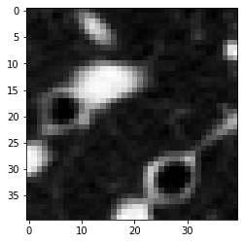
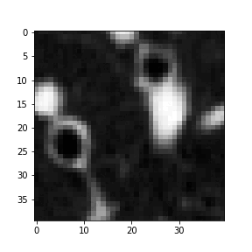
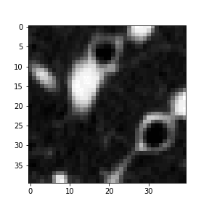
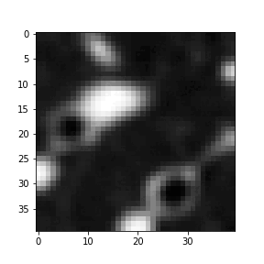
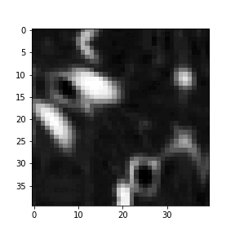
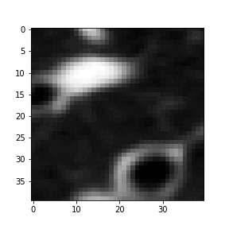
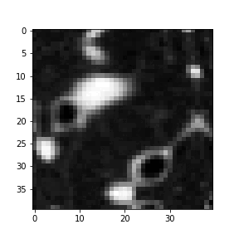
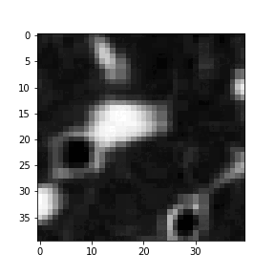

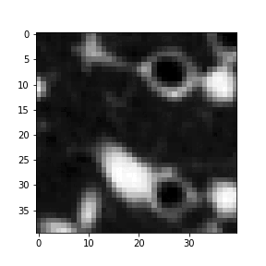

TRANSFORMATIONS
Applied to:
Original image
Archi 1
Archi 2
Archi 3
Rotate
Flip -Transpose
Blur
Grid Distortion
Perspective
Optical Distortion
Elastic Transform
Augmented image
Standard NumPy
Joint Probability
Advanced Albumentation
Exclusive Probability

Slide 11

Oversampled Dataset After Augmentation
7454
7370
3685
3727
DATASET FEATURES

Slide 12
ARCHITECTURES EVALUATION & COMPARISON
3

Slide 13
RECEPTIVE FIELD
Archi1
20x20x6
Archi2
30x30x10
Archi3
40x40x26

Slide 14
ARCHI 1 - STRUCTURE
Depth
Dense Layer
Global Max Pooling 3D
Max Pooling 3D
3D Conv. Layer
# Units
Kernel Height
Kernel Width
# Kernel
Conv3D - 1
(3, 5, 5, 32)
Max
Pool3D
(1, 1, 1)
Conv3D - 2
(3, 5, 5, 32)
Conv3D - 3
(1, 5, 5, 32)
Flatten
Dense
(ReLU)
(150)
Dense (Softmax)
(2)
6 Slices (20x20 pixels)
Conv3D - 3
(3, 5, 5, 32)
Global
MaxPool

Slide 15
ARCHI 2 - STRUCTURE
Depth
Dense Layer
Global Max Pooling 3D
Max Pooling 3D
3D Conv. Layer
# Units
Kernel Height
Kernel Width
# Kernel
Conv3D - 1
(3, 5, 5, 32)
Max
Pool3D
(1, 2, 2)
Conv3D - 2
(3, 5, 5, 32)
Conv3D - 3
(3, 5, 5, 32)
Global
MaxPool
Dense
(ReLU)
(250)
Dense (Softmax)
(2)
10 Slices (30x30 pixels)

Slide 16
ARCHI 3 - STRUCTURE
Depth
Dense Layer
Global Max Pooling 3D
Max Pooling 3D
3D Conv. Layer
# Units
Kernel Height
Kernel Width
# Kernel
Conv3D - 1
(3, 5, 5, 32)
Max
Pool3D
(2, 2, 2)
Conv3D - 2
(3, 5, 5, 32)
Conv3D - 3
(3, 5, 5, 32)
Global
MaxPool
Dense
(ReLU)
(250)
Dense (Softmax)
(2)
26 Slices (40x40 pixels)

Slide 17
ARCHI 1 – LOSS

Slide 18
ARCHI 1 – F1 SCORE

Slide 19
ARCHI 2 – LOSS

Slide 20
ARCHI 2 – F1 SCORE

Slide 21
ARCHI 3 – LOSS

Slide 22
ARCHI 3 – F1 SCORE

Slide 23
ARTICLE’S ARCHIs vs OURS
 | Archi 1 | Archi2 | Archi3
F1 score – Article* (Dou’s model structure) | 0,7714 | 0,7929 | 0,7431
F1 score – Our best | 0,8290 | 0,8836 | 0,8066
Improvement (percentage point) | + 5,76% | + 9.07% | + 6,35%
* score obtained by applying the article’s architecture to our dataset
Notes:
Here we compare the results for the first part of our work: apply the 3 models' used in Dou's article to our dataset (balanced in the standard way) and then try to optimize the model's hyperparameters and the dataset augmentation to improve performance : we succeded with all architectures. Obtaining the best results for archi 1 on advanced 4-0, archi2 on advanced 4-0 and archi 3 on advanced 9-1

Slide 24
MULTIMODAL NETWORKS
4

Slide 25
MULTIMODAL NETWORKS
1) Multimodal network with parallel convolutions and common classifier
Archi 1
Dense Layer
Global Max Pooling 3D
Max Pooling 3D
3D Conv. Layer
Concat
Archi 2
Dense
(ReLU)
(256)
Dense
(ReLU)
(128)
Dense (Softmax)
(2)
Archi 3

Slide 26
MULTIMODAL NETWORKS
2) Multimodal network with parallel convolutions and common convolution
Archi 1
Dense Layer
Global Max Pooling 3D
Max Pooling 3D
3D Conv. Layer
Concat
Conv3D
(3, 5, 5, 32)
Dense
(ReLU)
(250)
Archi 2
Global
MaxPool
Dense (Softmax)
(2)
Archi 3

Slide 27
COMMON CONVOLUTIONS

Slide 28
MULTIMODAL #2
 | F1 score | Recall | Precision
Standard | 0.448 | 0,527 | 0,442
Advanced (10-2) | 0,849 | 0,941 | 0,792
Improvement | + 40% | + 41.4% | + 35%

Slide 29
ENSEMBLE MODELS
5

Slide 30
WHY ENSEMBLES?
Advanced Dataset ( ):
Archi 1
Tot = 48
11
19
0
Archi 2
18
Archi 3
Tot = 80
27
16
46
Tot = 80
Number of missclassified samples

Slide 31
ENSEMBLE BUILDING APPROACHES
Gs-W) Gridsearch weights for each ARCHI for best aupr
Gs-T) Gridsearch prediction threshold for all ARCHIs for best f1
F1-W) Weight each ARCHI based on f1score on validation set
DT) Apply decision tree to all ARCHIs outputs
LR) Apply logistic regression to all ARCHIs outputs

Slide 32
RESULTS FOR: 5 TYPES OF ENSEMBLES – 3 DATASETS
F1 score | Gs-W | Gs-T | F1-W | DT | LR
Standard | 0.84 | 0,83 | 0,83 | 0,79 | 0,80
Advanced (19-3) | 0,73 | 0,85 | 0,81 | 0,73 | 0,78
Advanced (10-2) (only A1,2) | 0,92 | 0,85 | 0,91 | 0,90 | 0,90

Slide 33
BEST MODEL: linear combination of A1,2 on (10-2)
Advanced (10-2): wA1: 0,21 wA2: 0,79
AUPRC: 0.83
 | F1 score | Recall | Precision
Advanced (10-2) (only A1,2) | 0,92 | 0,99 | 0,85
426
14
- 400
- 350
- 300
- 250
- 200
- 150
- 100
- 50
0
1
AUROC: 0.98
1
82
0 1

Slide 34
BEST ENSEMBLE ANALYSIS
F1 based:
(10-2)
f1 A1: 0,86 f1 A2: 0,90
wA1: 3,34 wA2: 6,56
Logistic regression:
Archi2 ≤ 0,501
Archi1 ≤ 0,504
Archi2 ≤ 0,774
Archi2 ≤ 0,117
Archi2 ≤ 0,093
Entropy = 0,0
Entropy = 0,168
Entropy = 0,971
Entropy = 0,592
Archi1 ≤ 0,985
Archi1 <= 0,981
Entropy = 0,694
Entropy = 0,544
Entropy =
0.0
Entropy = 0,183
Decision tree:

Slide 35
CONCLUSIONS
6

Slide 36


Balanced loss instead of data augmentation
Low data variability
Best results
Augmentation
Multimodal networks
Too many parameters

Slide 37
2D Network – MobilNet (Transfer Learning & Fine Tuning)
Best Archi 1 vs 2D MobileNet Performances

Slide 38
3D Network – Custom 3D ResNet
Best Archi 1 vs 3DResNet Performances
3DResNet Main Blocks
Identity Block
Conv. Block
+
+
3D Conv
3D BatchNorm
ReLU

Slide 39
THANK YOU FOR YOUR ATTENTION!

Slide 40
ADDITIONAL RESULTS

Slide 41
DIFFERENCES IN WHAT EACH ARCHI LEARNS:
Standard Dataset ( ):
Advanced Dataset ( ):
Archi1
Archi1
Tot = 38
Tot = 48
13
11
5
7
19
0
13
18
Tot = 111
84
9
10
Tot = 80
27
16
46
Archi2
Archi3
Archi2
Archi3
Tot = 39
Tot = 80
Number of common missclassified samples for Archi 1 – 2 - 3

Slide 42
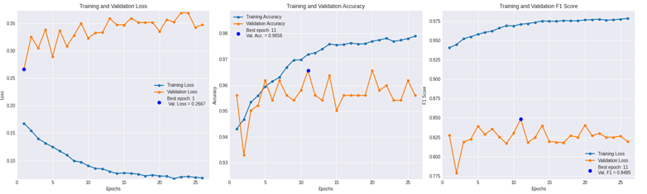
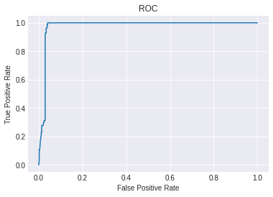
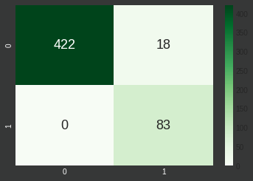
MULTIMODAL WITH PARALLEL AND COMMON CONVOLUTIONS
AUROC: 0,9766

Slide 43
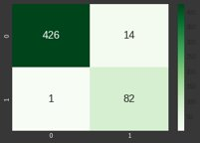
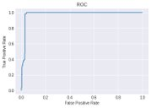
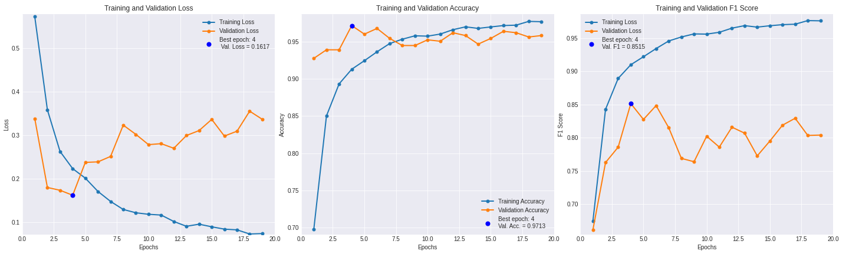
MULTIMODAL WITH PARALLEL CONVOLUTIONS AND COMMON CLASSIFIER
 | F1 score | Recall | Precision
Standard | 0.816 | 0,941 | 0,736
Advanced (10-2) | 0,852 | 0,929 | 0,807
Improvement | + 3,6% | -1,2% | + 7,1%
AUROC: 0,9801

Slide 44
GRIDSEARCH PREDICTION THRESHOLD FOR BEST F1SCORE
Standard: thr: 0.43
Advanced (19-3): thr: 0.66
Advanced (10-2): thr: 0.36
 | F1 score | Recall | Precision
Standard | 0.83 | 0,90 | 0,77
Advanced (19-3) | 0,85 | 0,87 | 0,83
Advanced (10-2) (only A1 and A2) | 0,85 | 0,87 | 0,83

Slide 45
WEIGHT EACH ARCHI BASED ON F1SCORE FOR SEPARATE VALIDATION SET
Standard: f1 A1: 0,80 f1 A2: 0,33 f1 A3: 0,76
Advanced (19-3): f1 A1: 0,81 f1 A2: 0,75 f1 A3: 0,66
Advanced (10-2): f1 A1: 0,86 f1 A2: 0,90
 | F1 score | Recall | Precision
Standard | 0.83 | 0,88 | 0,79
Advanced (19-3) | 0,81 | 0,99 | 0,69
Advanced (10-2) (only A1 and A2) | 0,91 | 0,98 | 0,85

Slide 46
APPLY DECISION TREE TO ALL ARCHIS OUTPUTS (INTERPRETABLE)
 | F1 score | Recall | Precision
Standard | 0.79 | 0,90 | 0,71
Advanced (19-3) | 0,73 | 0,96 | 0,58
Advanced (10-2) (only A1 and A2) | 0,90 | 0,96 | 0,85

Slide 47
APPLY DECISION TREE TO ALL ARCHIS OUTPUTS (INTERPRETABLE)
Standard

Slide 48
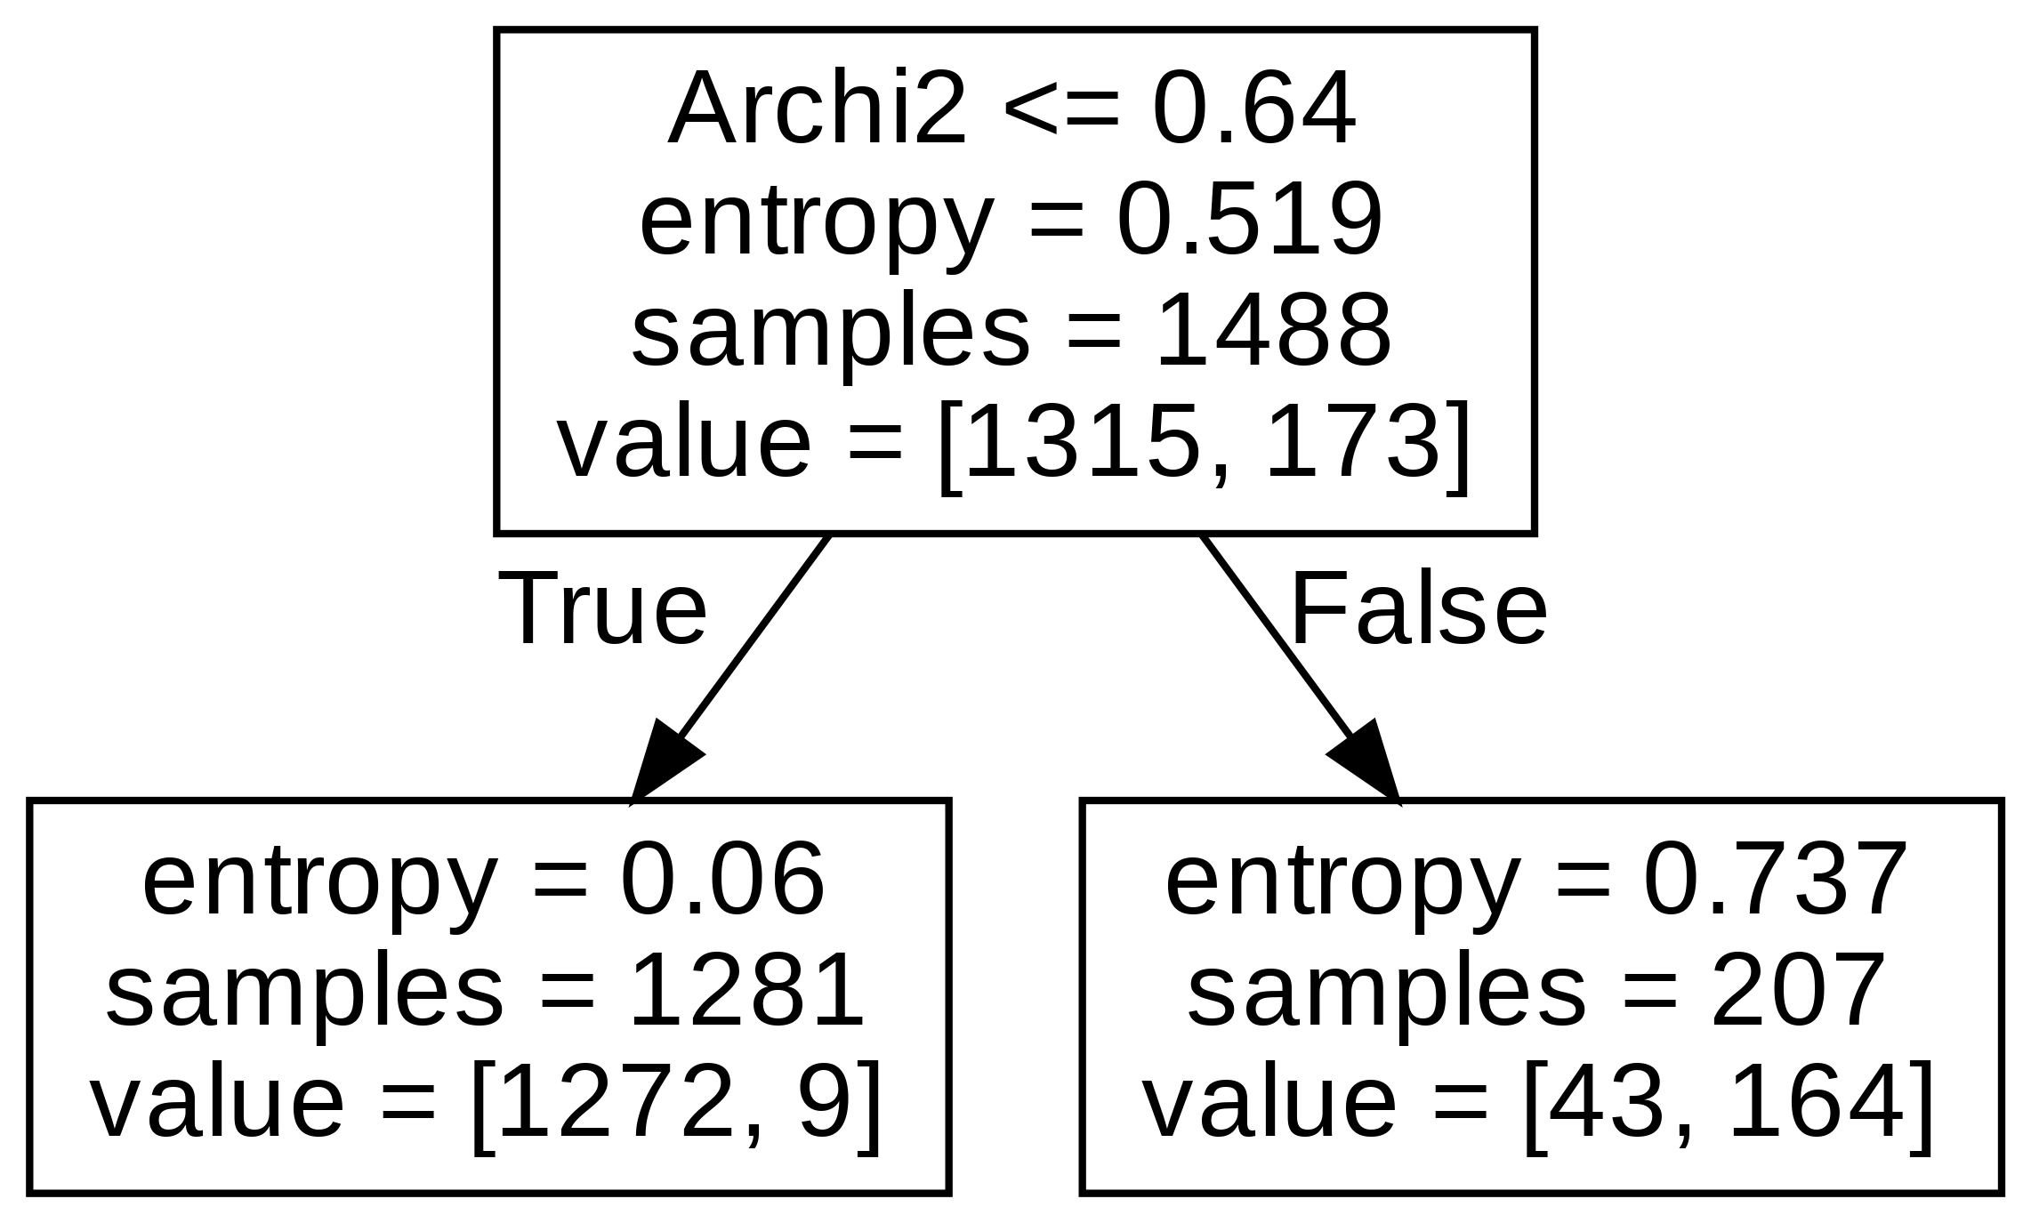
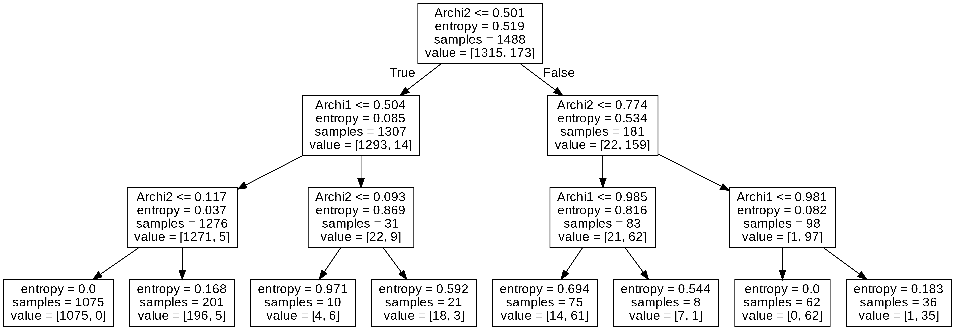
APPLY DECISION TREE TO ALL ARCHIS OUTPUTS (INTERPRETABLE)
Advanced 19-3
Advanced 10-2 (only archi 1 and 2)

Slide 49
APPLY LOGISTIC REGRESSION TO ALL ARCHIS OUTPUTS (INTERPRETABLE)
Standard: wA1: 4,02 wA2: 4,47 wA3: 2,76
Advanced (19-3): wA1: 1,76 wA2: 5,48 wA3: 3,04
Advanced (10-2): wA1: 3,34 wA2: 6,56
 | F1 score | Recall | Precision
Standard | 0.80 | 0,77 | 0,82
Advanced (19-3) | 0.78 | 0,73 | 0,82
Advanced (10-2) (only A1 and A2) | 0,90 | 0,96 | 0,85

Slide 50
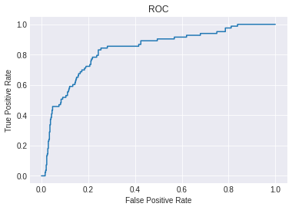
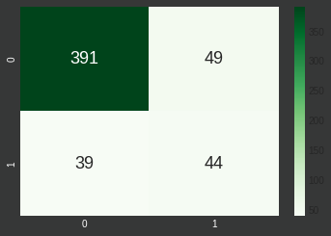
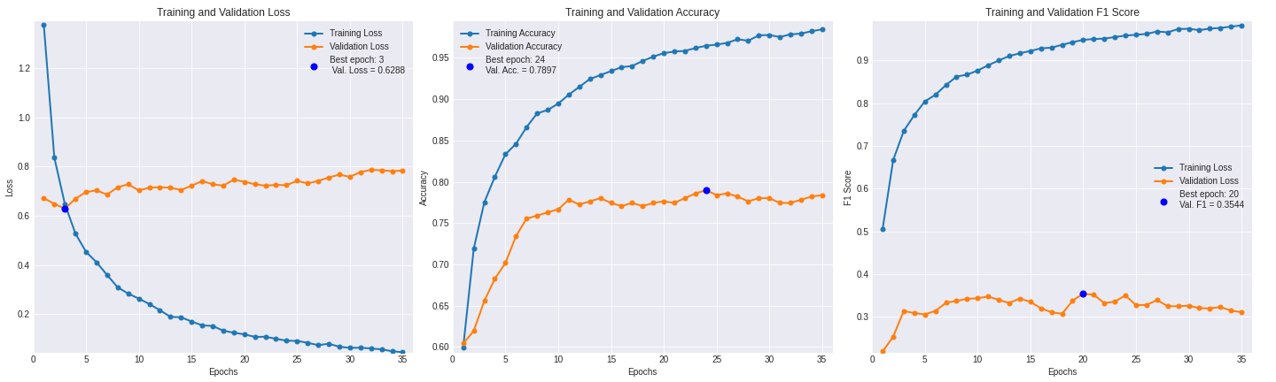
2D NETWORK: MOBILENET TRANSFER LEARNING AND FINE TUNING FROM IMAGENET WEIGHTS USING THE 3 CENTRAL SLICES
AUROC: 0,8288

